Slide 1
1.Characters Introduced in Context
Day 1
Nǐ 认shi tā mɑ ? Tā shì Zhōngguó人 ma？
Bù, tā shì Měiguó人.
A Book Cover
Image from http://tinyurl.com/9z682nj

Slide 2
1.Characters Introduced in Context
Day 1
Nǐ 认shi tā mɑ ? Tā shì nǎli 人？
Tā shì Jiāzhōu人.
Image from http://tinyurl.com/8hzn4ye

Slide 3
1.Characters Introduced in Context
Day 1
Nǐ 认shi tā mɑ ? Tā shì nǎli人？
Tā shì fúluólǐdá人.
Image from http://tinyurl.com/8cfycu7

Slide 4
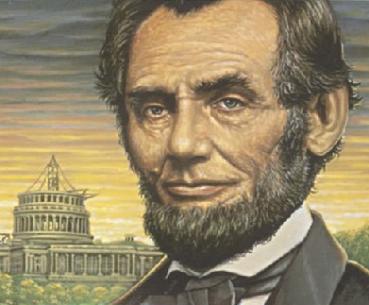
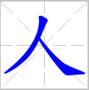
2. Recognize Character Component
Day 1
Compare these two characters and identify the similarities and differences.
Identify the two components of the first character.

Slide 5
3. Component Order → Stroke Order
Day 1
The two components are identified.
Which part will you write first?

Slide 6
3. Component Order → Stroke Order
Day 1
This character entails two strokes. Which stroke should be written first?
Měi guó人
Jiāzhōu人
Fúluólǐdá人

Slide 7
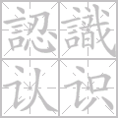
3. Component Order → Stroke Order
Day 1
How would you write认识 de认?
Did you get it right?
Group Discussion: Inference What is the basic stroke order in Chinese?
Left → Right; Top → Bottom

Slide 8
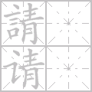
4. Identify the Semantic Radical
Day 1
Think – Pair – Share: Compare these three characters and identify the similarities and differences. Which part of the above characters will you write first, left or right?
Hands-on Activities: Divide into pairs. Observe and learn how to write one character in the right stroke order, can you follow the example and teach your partner?
Group Discussion: What may be the function of the part on the left?

Slide 9
5. Compare the Internal Structures
Day 1
Think – Pair – Share: Now that you have learned the above characters, circle two characters from the list below, which share the same internal structure as the characters above? Please elaborate on your reasoning.
叫、菜、吃、茶

Slide 10
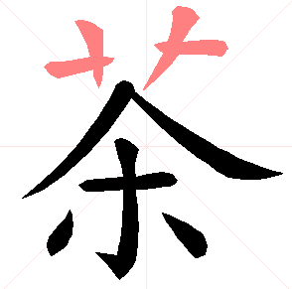
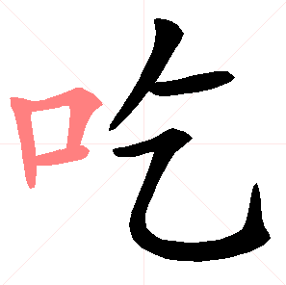
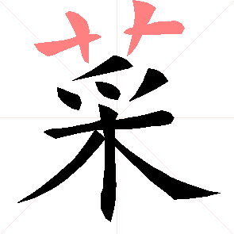
Day 1
5. Compare the Internal Structures
Think – Pair – Share: 叫、菜、吃、茶

